Slide 1
Heartfelt
TEAM 4
By: Sensen Chen, Connor Griffin, Mengyi Li, Maria Salmon, Claire Zhu

Slide 2
Verbs:
Seduce & Repair

Slide 3
Game Idea
You have been seduced and, due to this you lose your heart. Without your heart you can’t love or be loved
In order to get it back you appear in a dungeon/maze where your heart has been broken into 5 pieces
You must defeat (seduce) the individuals (enemies) that guard the pieces of your heart
When your enemy is seduced, you may retrieve your heart piece
Once all pieces to your heart are collected you may love/be loved again

Slide 4
Summary
Quick dungeon crawler
Small backstory
Fast-paced key-triggered combat
Fun & entertaining play!

Slide 5
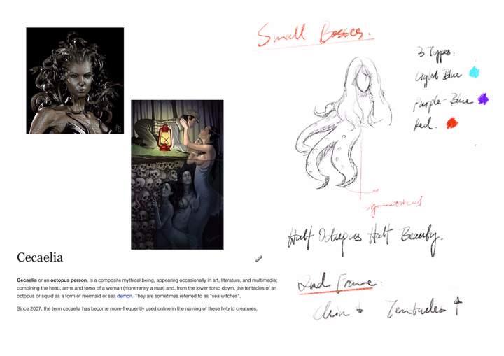
Art - Sketches & Ideas

Slide 6

Art - Player Character

Slide 7



Art - Enemies

Slide 8

Enemies (cont.) - Final Boss

Slide 9



Art - Attacks & Environment

Slide 10






Art - Heart (Objective)

Slide 11
Story
“Seduction” - Combat, Cause, Conclusion
“Repair” - Objective, Conclusion
Player is protagonist vs. player playing as a protagonist
Stupid but makes sense

Slide 12
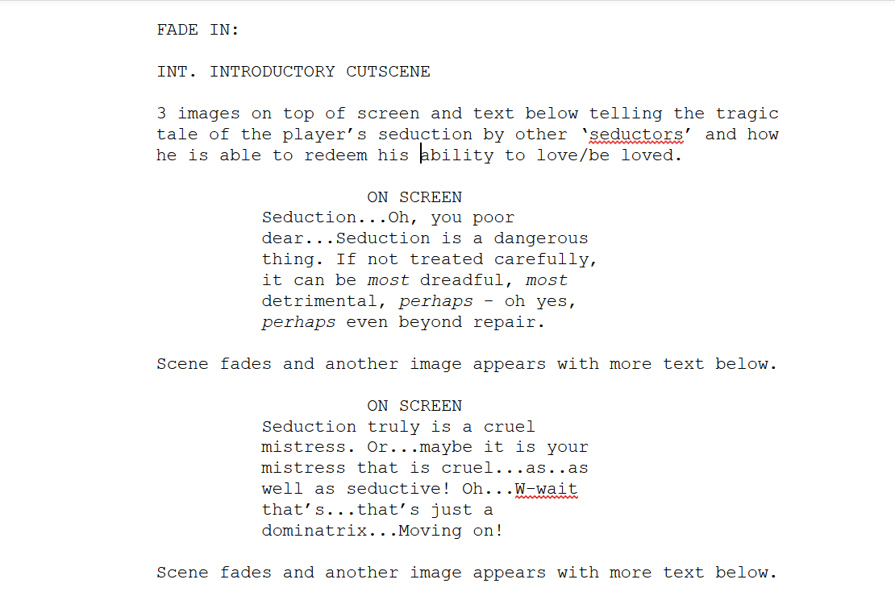
Story - Script sample

Slide 13
Story - Script Reading
Introduction
3 Parts
Before Boss Battle
1 Part
After Boss Battle
Fail Ending:
3 Parts
Win Ending:
3-4 Parts

Slide 14
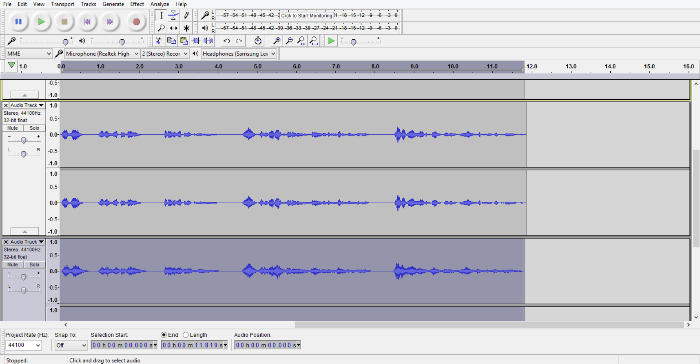
Story - Recording Example

Slide 15
Sound
Boss Theme
Main Theme
Gets more complicated as more pieces of the Heart is collected
5 separate songs that are layered
Attack noises
‘Kiss’
‘Leg’
‘Nether Regions’
Death sounds
One for each of the three enemies
Three possible sounds for player death

Slide 16
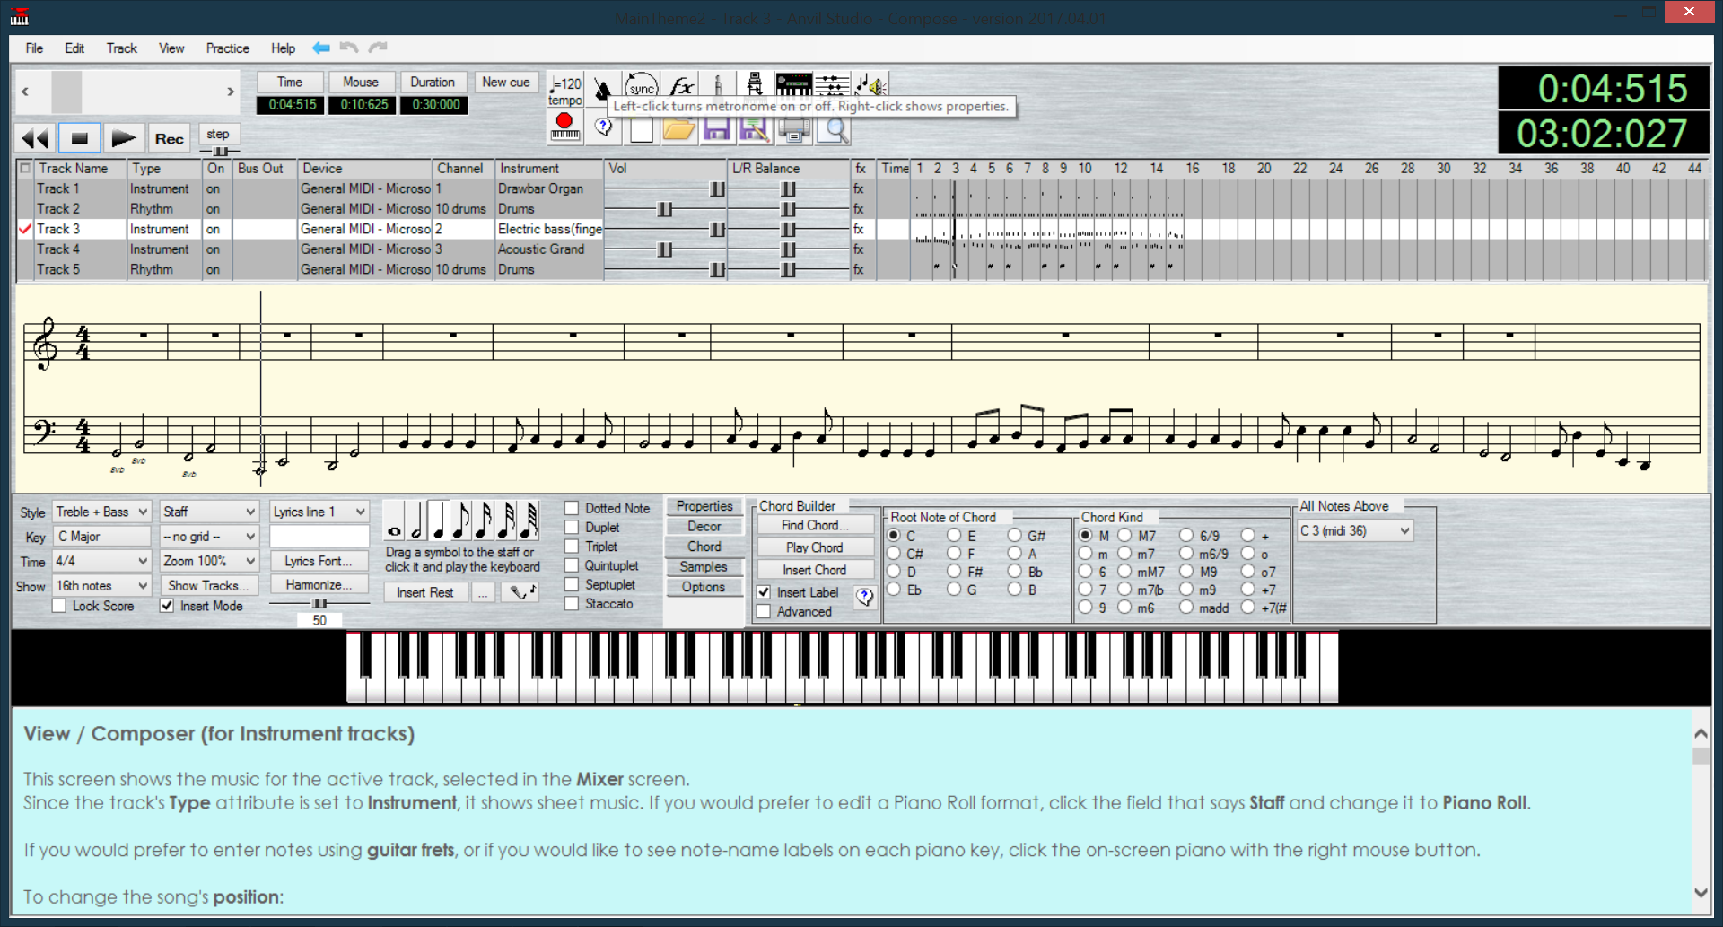
Sound - Composition Example

Slide 17
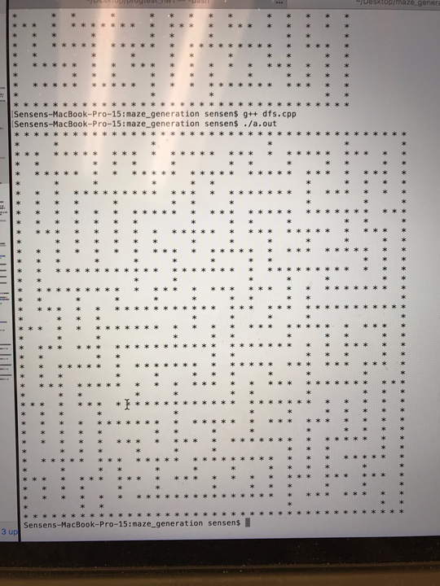
Programming - Early Stages

Slide 18
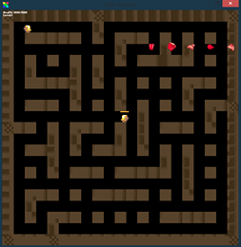
Programing - Halfway Point

Slide 19
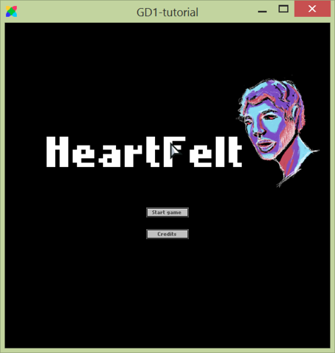
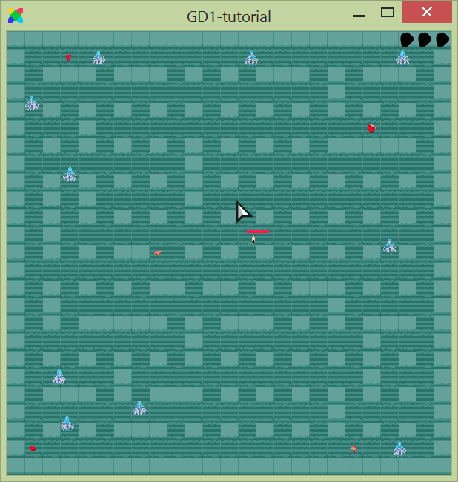
Programing - Final Product

Slide 20
Our thoughts on the project
Cheesy
Corny
Classy
Of course we wanted innuendos when we got the verb ‘Seduction’.
We just also wanted to be a little elegant with it.
We hope we succeeded.

Slide 21
Why we did what we did
Fit within the time constraints
While still having:
Story
Combat animations
Multiple enemies in a randomly generated area
Not go for the lower-hanging fruit with our ‘seduction’ and ‘repair’ task
Create a fun environment
Make a PG game
A 2017 PG rating not a 90s PG rating - 90s PG ratings actually meant something, 2017 PG is PG-13 stop lying to yourself

Slide 22
Conclusions
Our original idea changed drastically once development began:
Initial RPG v.s. Final Dungeon-esque
Initial Click-Combat v.s. Final Key-Based
Initial Multiple Levels v.s. Final Randomly-Generated Single Map
Initial Turn Based v.s. Final Real-Time Combat
Most importantly, though:
Initial BIG DREAMS v.s. Final ACHIEVABLE WITHIN A 2 WEEK TIMEFRAME DREAMS

Slide 23
Questions?

